Slide 1
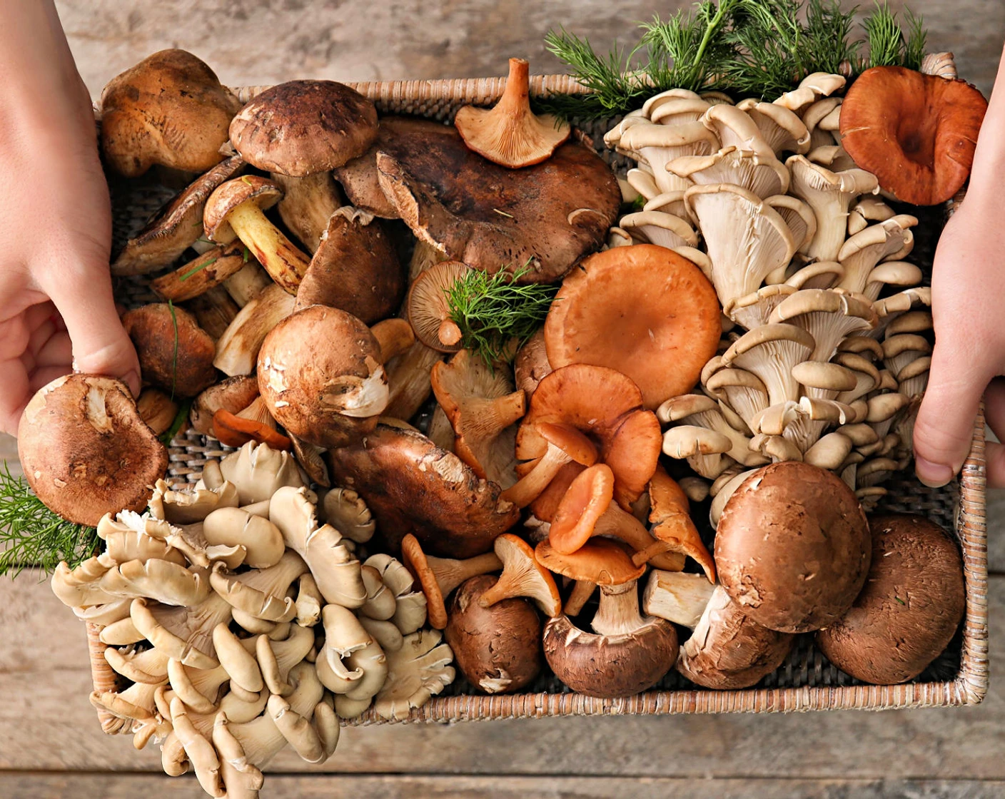

Binary Prediction of Poisonous Mushrooms
Dataset: Kaggle Playground Series (S4E8) Course: CSE 572 Data Mining Group Members: Luna Sbahtu, Molly Shircliff, Bright Mudzingwa, Pardon Hlongwane
Checkpoint: 2 – Predictive Methods

Slide 2

Checkpoint 2: Overview
Predictive Methods
Results & Issues
Improvements Proposed & Results
Future Steps

Slide 3
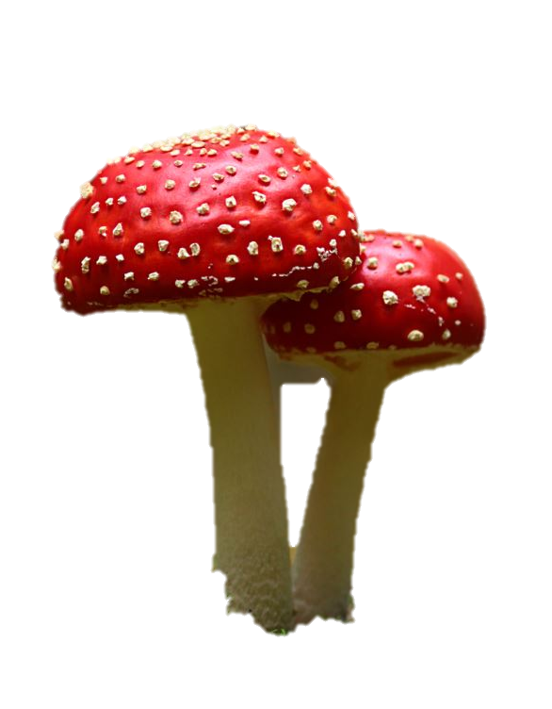
Predictive Methods
Chose to perform 3 separate models:
Logistic Regression Classifier
Use this model as a baseline. Is there a linear relationship between classes?
Random Forest Classifier
This is preferred if there is nonlinear relationship. It is better than Decision Tree to check multiple split combinations
AdaBoost
This is a further improvement on random forest, but slower. Will it be worth the computational tradeoff?

Slide 4
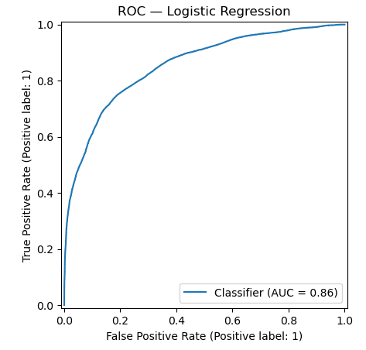
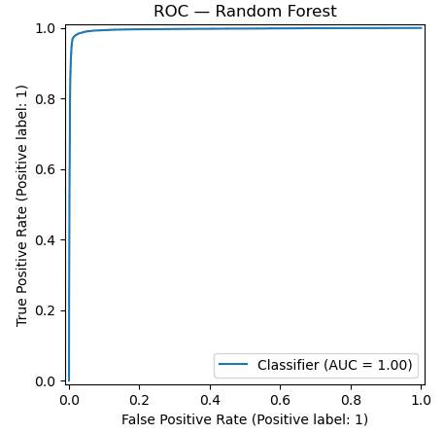
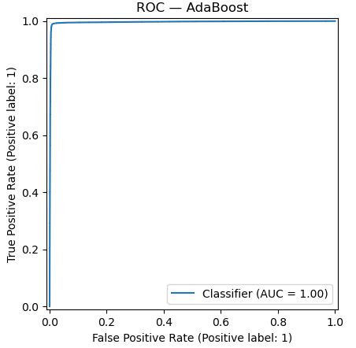
Model Baseline Results
Due to the large dataset (> 3m rows), models were created with 10% random sampling with replacement. In order to keep class proportions balanced, a stratified split was also applied when creating the train-test split for modeling.
Model | Accuracy | F1 | ROC
Logistic Regression | 78.02% | 0.773 | 0.8551
Random Forest | 98.06% | 0.981 | 0.995
AdaBoost | 98.99 | 0.9899 | 0.996

Slide 5
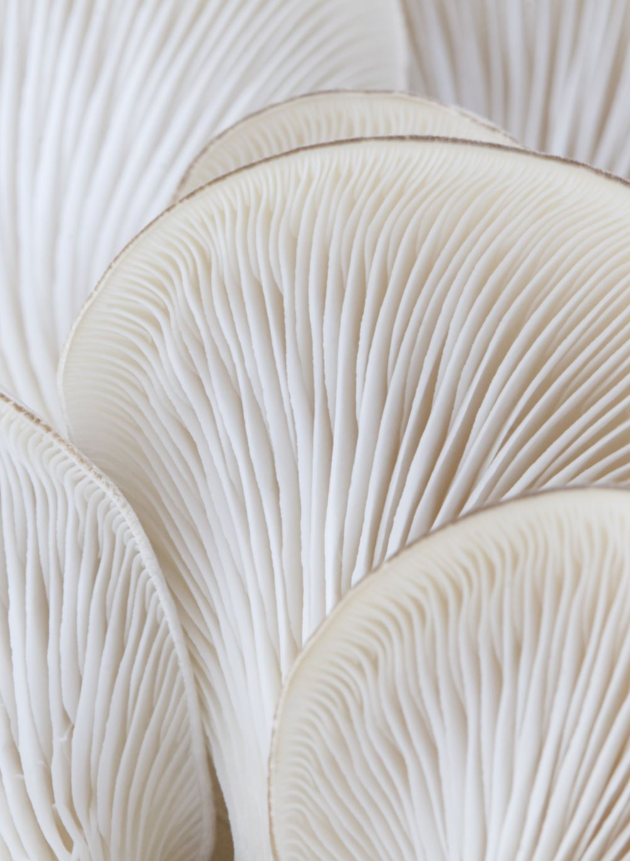


Baseline Model Discussion
Logistic Regression performed worst (78.02% accuracy)
Potential causes:
Non-linear boundary between edible & poisonous class
Feature interactions
Random Forest & AdaBoost performed best, with AdaBoost performing slightly better (0.9% improvement)
Decision:
Choose Random Forest & AdaBoost to perform improvements on

Slide 6
Improvements Proposal
5-fold cross validation
Ensure that accuracy values are correct and not overfitted
Grid search & hyperparameters analysis
Determine best parameters for better error metrics

Slide 7
5-Fold Cross Validation
Model | Fold 1 | Fold 2 | Fold 3 | Fold 4 | Fold 5 | Avg
Random Forest | 97.85 | 97.88 | 98.18 | 97.97 | 98.1 | 98.05%
AdaBoost | 98.90 | 98.94 | 98.94 | 98.95 | 98.94 | 98.93%
The average of both models matches their individual predictions. Thus, both models are well-fitted to both train & test data.

Slide 8
Grid Search & Hyperparameters Analysis: Random Forest
Model | Hyperparamters Baseline | Hyperparameters Attempted
Random Forest | n_estimators=100, max_depth=14, min_samples_leaf=10, max_features='sqrt' | n_estimators={64,100,200} max_features={2,3,4} bootstrap = {True,False} oob_score = {True,False}
Goal: try different number of trees, number of features used to consider best split, try utilizing the whole dataset to build tree
Results:
with this grid search, could only achieve accuracy of 75%.
It appears that max_features has the most effect on accuracy for this dataset. Utilizing the square root (features) returns best accuracy.
Can achieve 99% accuracy if max_depth & min_samples_leaf are set to default. However, this takes too long computationally. There is tradeoff between the time and model accuracy.

Slide 9
Grid Search & Hyperparameters Analysis: AdaBoost
Model | Hyperparamters Baseline | Hyperparameters Attempted
AdaBoost | n_estimators=1, max_depth=2, learning_rate=1 | n_estimators={1,100,200} max_depth={2,4,10} learning_rate = {0.5,1,2}
Goal: try different number of estimators for ensemble learning, different tree depths, and the weight (learning rate) applied to each classifier

Slide 10
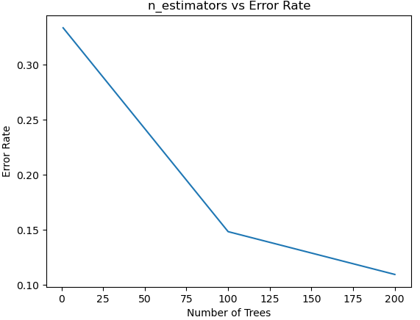
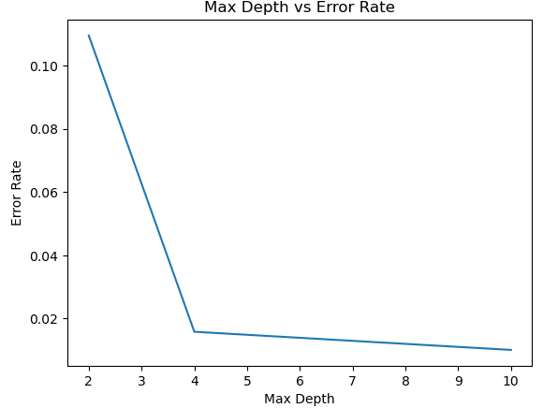
Grid Search & Hyperparameters Analysis: AdaBoost
Results: with the baseline hyperparameters, accuracy was ~75%. 200 estimators performed best, with accuracy at 89% for depth = 2. Accuracy continued to improve as depth increased.

Slide 11

Future Work
Try SVM model to compare with random forest & AdaBoost
This will provide us with 4 models of comparison: logistic reg, random forest, AdaBoost, and SVM
Is there any further feature engineering that we can do to the dataset? Will it improve accuracy?

Slide 12
Conclusion
Random forest and AdaBoost baseline models return the best accuracy & fit. AdaBoost performs slightly better.
In order to achieve such high accuracy, hyperparameters for random forest & AdaBoost were tuned.
Will create SVM model for further comparison.
Determine best overall model and further fine tune as able.

Slide 13
Links
Jupyter Notebook Codes:
https://github.com/molls1889/DataMiningCheckpoint2
Video Link:
https://drive.google.com/file/d/1_fgVO7SqU7DOsG0cj6_H8MSs28kzjIEi/view?usp=drive_link

